Slide 1


Business Data analysis /商业数据分析
MARKETING/市场营销部门项目
Following the money is always a good way to identify business opportunities/跟着钱走总能发现商业机会

Slide 2
Business Data analysis/商业数据分析
MARKETING/市场营销部门项目
Type of Marketing Campaigns/市场营销活动的主要种类
  Product Marketing Campaign/产品营销活动
  Acquisition Marketing Campaign/客户获得
  Customer retention Campaign/客户挽留
Budget/预算: Not all marketing campaigns require an incremental budget, but many still do. Factor in the agency, advertising, and freelance costs, if appropriate, and factor these numbers into any ROI analysis/投资回报分析 for your campaign.

Slide 3
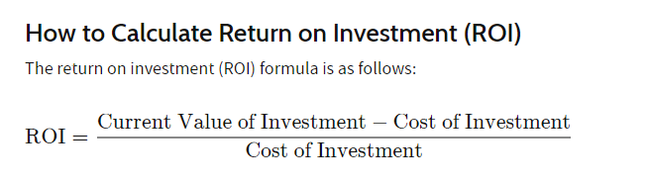
Business Data analysis /商业数据分析
MARKETING/市场营销部门项目
怎么算促销活动的回报？

Slide 4
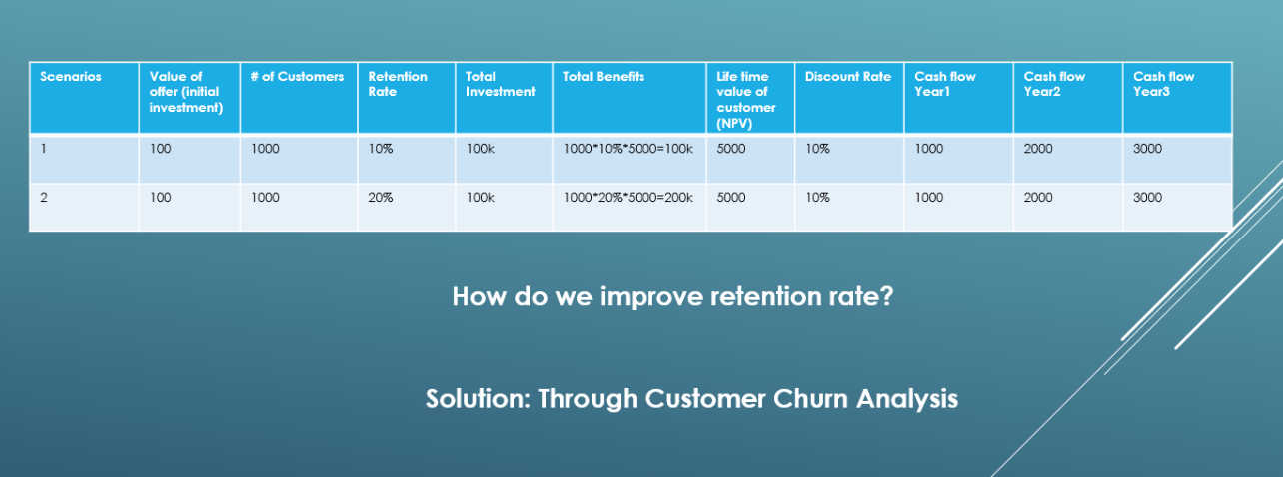
Business Data analysis /商业数据分析
ROI Financial analysis
随机
非随机

Slide 5
Business Data analysis /商业数据分析
Churn analysis/客户流失分析
Churn analysis is a review of a bank’s customers data that reveals their composition and trends. It looks for correlations between customers who became inactive during a period of time and variables such as tenure, product holding, service calls, seasonality, and demographics.
客户流失分析是分析银行客户组成和趋势的数据。寻找客户的特征比如时间长度，持有什么产品，打过服务电话，季节性，人口成分等与客户流失的关联。

Slide 6
Business Data analysis /商业数据分析
Churn analysis/客户流失分析---data 数据
CustomerId | CreditScore | Geography | Gender | Age | Tenure | Balance | NumOfProducts | HasCrCard | IsActiveMember | EstimatedSalary | Churn
15592531 | 822 | France | Male | 50 | 7 | 0 | 2 | 1 | 1 | 10062.8 | yes
15577657 | 732 | France | Male | 41 | 8 | 0 | 2 | 1 | 1 | 170886.17 | Yes
15614049 | 664 | France | Male | 55 | 8 | 0 | 2 | 1 | 1 | 139161.64 | yes
15640635 | 769 | France | Male | 29 | 8 | 0 | 2 | 1 | 1 | 172290.61 | yes
15724944 | 663 | France | Male | 34 | 7 | 0 | 2 | 1 | 1 | 180427.24 | yes
15625524 | 512 | France | Male | 40 | 5 | 0 | 2 | 1 | 1 | 146457.83 | No
15789669 | 510 | France | Male | 65 | 2 | 0 | 2 | 1 | 1 | 48071.61 | No
15810845 | 636 | France | Male | 42 | 2 | 0 | 2 | 1 | 1 | 55470.78 | No
15656176 | 501 | France | Male | 57 | 10 | 0 | 2 | 1 | 1 | 47847.19 | No
15624592 | 603 | France | Male | 31 | 8 | 0 | 2 | 1 | 1 | 169915.02 | No
15727829 | 567 | France | Male | 42 | 2 | 0 | 2 | 1 | 1 | 167984.61 | No
15636684 | 727 | France | Male | 34 | 10 | 0 | 2 | 1 | 1 | 198637.34 | yes
15653857 | 498 | France | Male | 34 | 2 | 0 | 2 | 1 | 1 | 148528.24 | yes
15668893 | 782 | France | Male | 39 | 8 | 0 | 2 | 1 | 1 | 33949.67 | yes
15785819 | 681 | France | Male | 38 | 3 | 0 | 2 | 1 | 1 | 112491.96 | yes
15811490 | 627 | France | Male | 33 | 5 | 0 | 2 | 1 | 1 | 103737.82 | yes
15576256 | 582 | France | Male | 39 | 5 | 0 | 2 | 1 | 1 | 129892.93 | yes
15676715 | 640 | France | Male | 68 | 9 | 0 | 2 | 1 | 1 | 199493.38 | yes
15642291 | 685 | France | Male | 23 | 8 | 0 | 2 | 1 | 1 | 112239.03 | yes

Slide 7
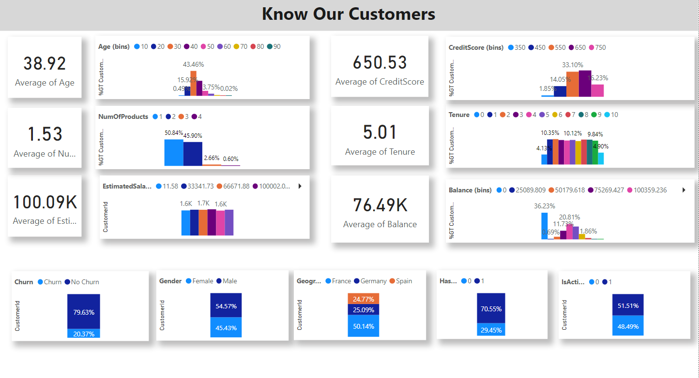
Summarize your data/总结你的数据
The power of visualization/视觉化的威力

Slide 8
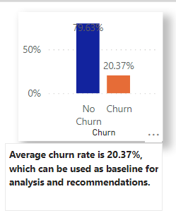
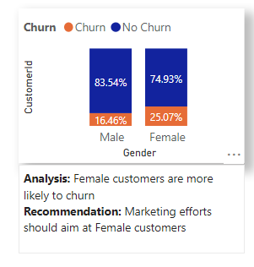
CHURN ANALYSIS
Baseline/基线

Slide 9

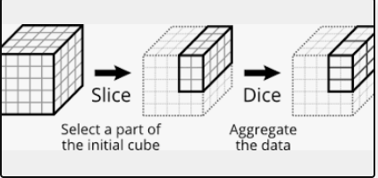
CHURN ANALYSIS
三板斧：切，统计总和，比较

Slide 10
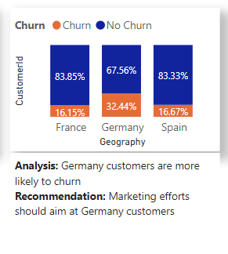
CHURN ANALYSIS
Baseline/基线

Slide 11
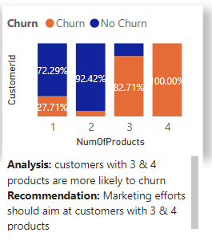
CHURN ANALYSIS
Baseline/基线

Slide 12
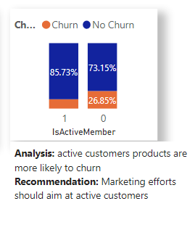
CHURN ANALYSIS
Baseline/基线

Slide 13
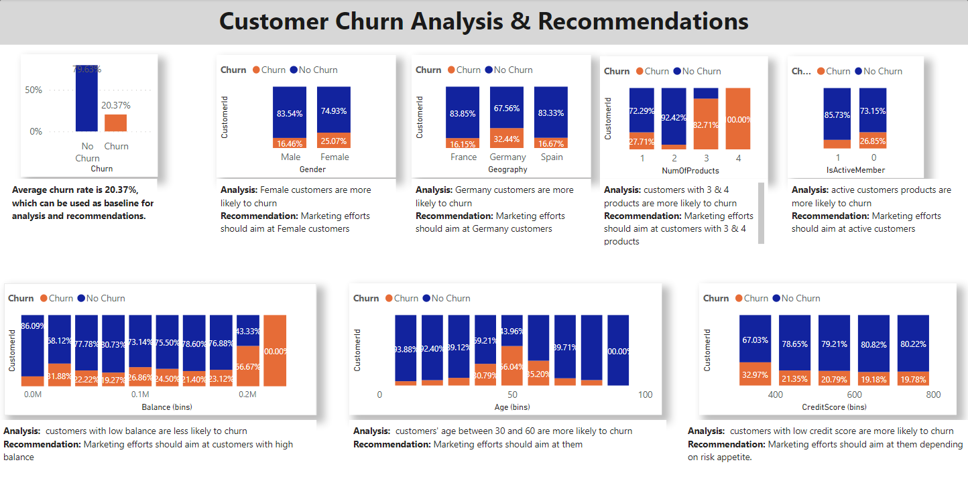
CHURN ANALYSIS

Slide 14
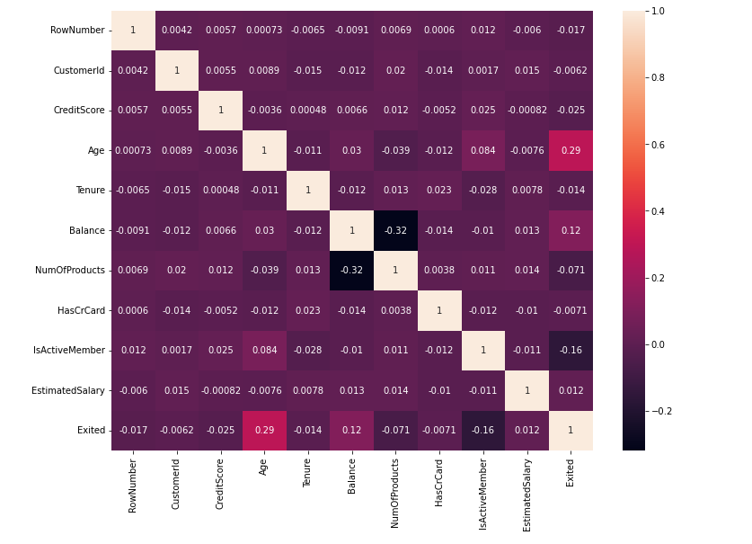
CHURN ANALYSIS--- correlation /关联

Slide 15
CHURN ANALYSIS
Quantify/量化
One to Many/一对多关系
Ranking/排序

Slide 16
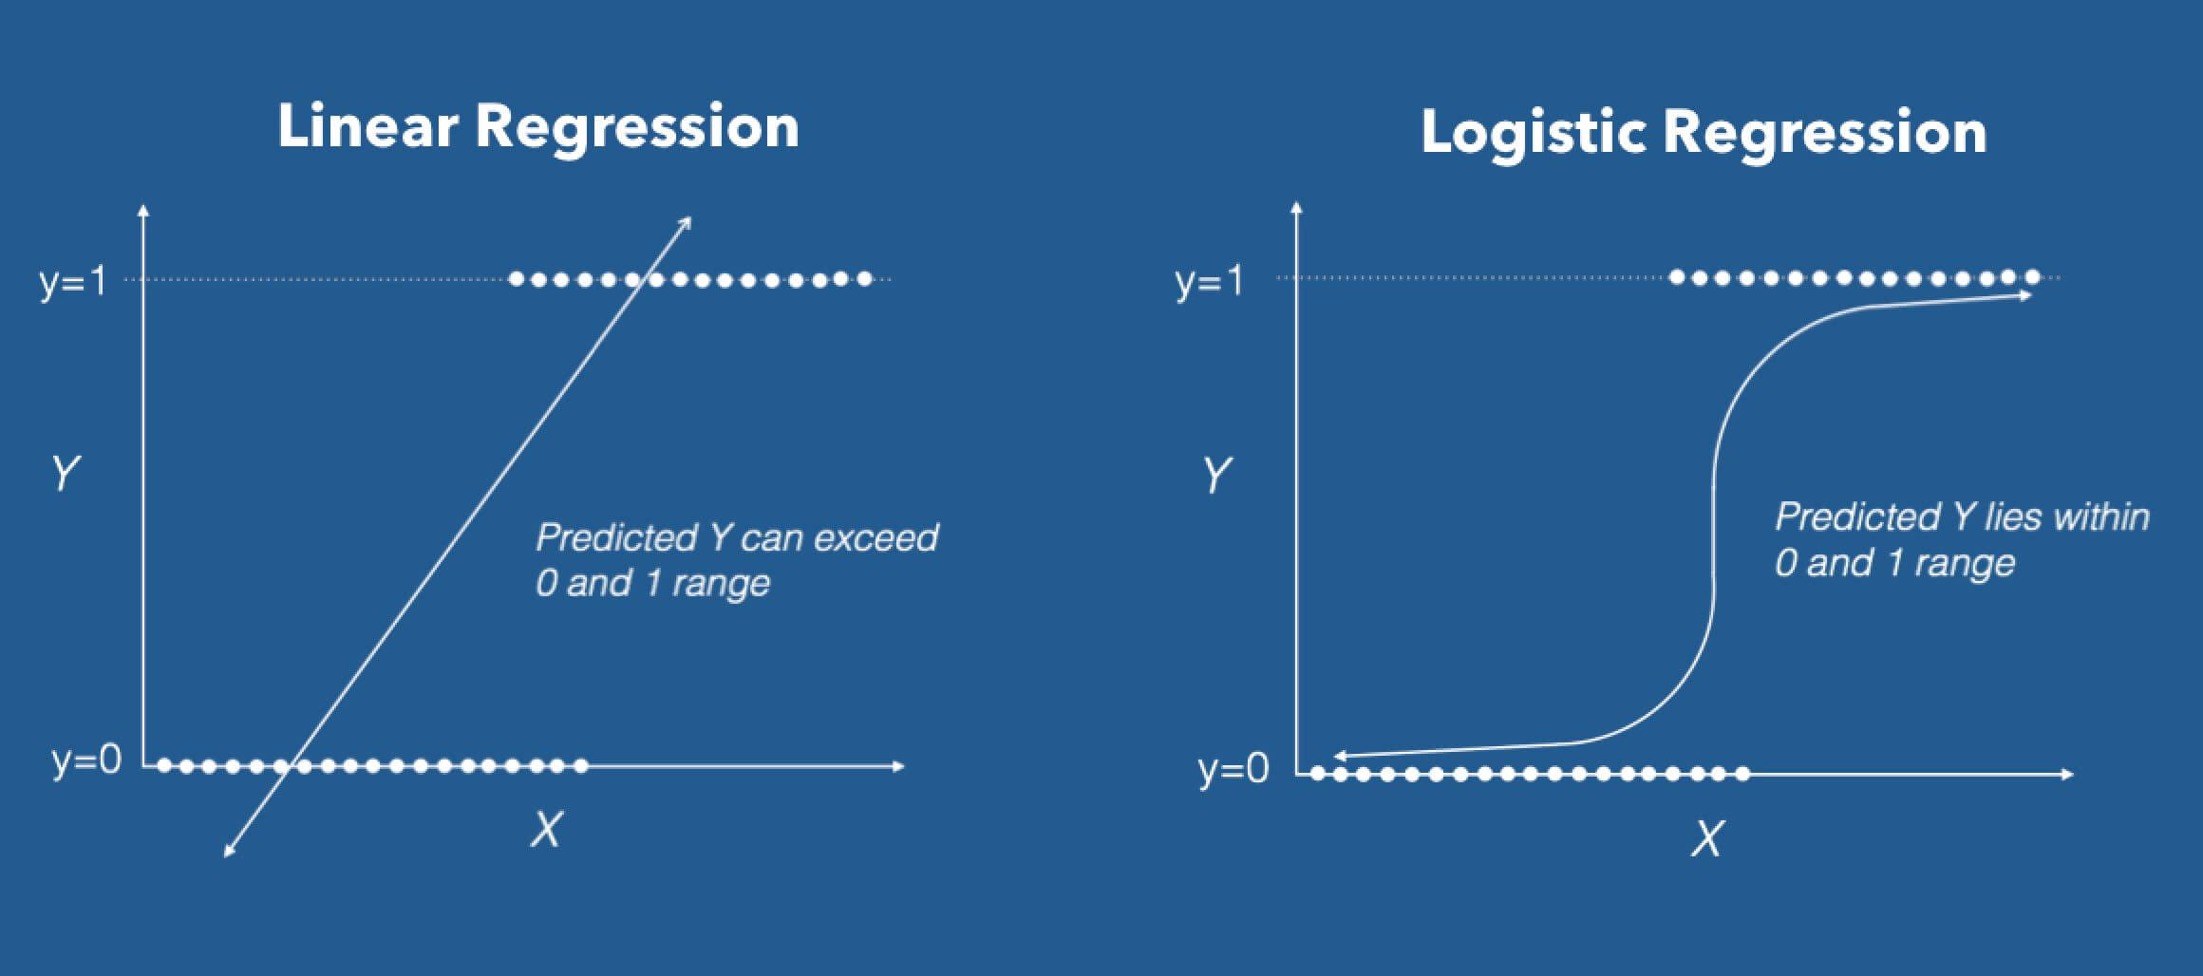
CHURN ANALYSIS
REGRESSION/回归

Slide 17
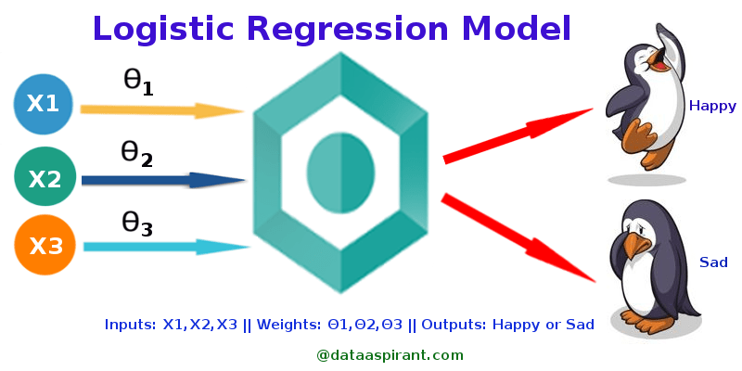
CHURN ANALYSIS
REGRESSION/回归

Slide 18
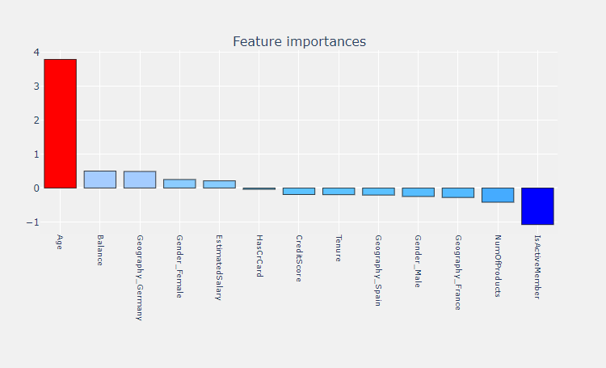
CHURN ANALYSIS---REGRESSION/回归

Slide 19
CHURN ANALYSIS---REGRESSION/回归
Churn/流失
CreditScore
Age
Quantify/量化
One to Many/一对多关系
Ranking/排序
Explain/解释
Control/控制
Predict/预测
Geography
Tenure
Gender
Balance
Regression Model 回归分析模型

Slide 20
CHURN ANALYSIS
面试怎么讲
  有相关经验
  没有相关经验
常见面试问题：
  Tell me one time you use data to generate insights?
    Identify Business problems
    Identify data analysis solutions
    visualize the insights
    Present analysis and recommendations
    Here is one example I have done(have experience)/here is my approach(no experience)
  How do you find business opportunities/problems
    identify business goals, e.g. marketing needs to retain customers…
  How do you do data analysis?
    Data life cycle at high level
  How do you prepare data?
    Data Architecture

